Slide 1

Aquatic Services and Facilities Strategy – Stage 3
Council Meeting
March 10, 2026
Parks, Recreation and Culture

Slide 2
PURPOSE
To provide Council with the Aquatic Services and Facility Strategy – Stage 3 Draft Strategy and seek approval to undertake further community consultation before presenting Stage 4 Final Strategy for Council’s consideration.

Slide 3
SUMMARY OF THE ISSUE
Council’s 2022 – 2026 Strategic Plan identified the need to develop an Aquatic Services and Facilities Strategy (Strategy) to study the current and future needs for aquatic services, including required investments in existing and potentially new infrastructure.
Development of the Strategy enables the City of Abbotsford (City) to consider the support of aquatic services and related facilities in Abbotsford.
This Stage 3 Draft Strategy builds on the comprehensive research and community input gathered after Stage 2 and offers a framework for how the City can respond to current aging facilities, meet future demand, and create and sustain a modern, inclusive aquatic system over the next 20 years.

Slide 4
CONTEXT
Abbotsford’s aquatic facilities are well used and deeply valued.
However, the infrastructure that supports these experiences is aging and under increasing strain and associated maintenance.
ARC and MRC Pools, along with Centennial Outdoor Pool, are facing lifecycle issues that will necessitate significant capital works to maintain these amenities, while not necessarily increasing capacity.
At the same time, population growth, demographic shifts, and rising demand for flexible, unstructured aquatic programs are intensifying pressure on these facilities.

Slide 5
BACKGROUND
At the July 22, 2025 Regular Meeting, Council directed staff to undertake community consultation for the proposed approaches to service level, facility number and locations through a centralized or decentralized model, facility use intentions, timeline and sequence for significant directions potentially arising from the approval and implementation of the Strategy.
Based on data provided, projected demand by 2045 from population growth alone would require the City to provide for 710,000 annual swims to sustain the existing service level.
Staff have gathered the community’s input, concluded the consultation process and are providing the Draft Strategy for Council’s review.

Slide 6
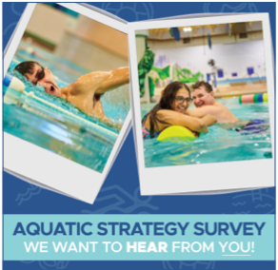
DISCUSSION
Process Update
Strategy Recap
Community Feedback
Strategy Direction
Next Steps

Slide 7
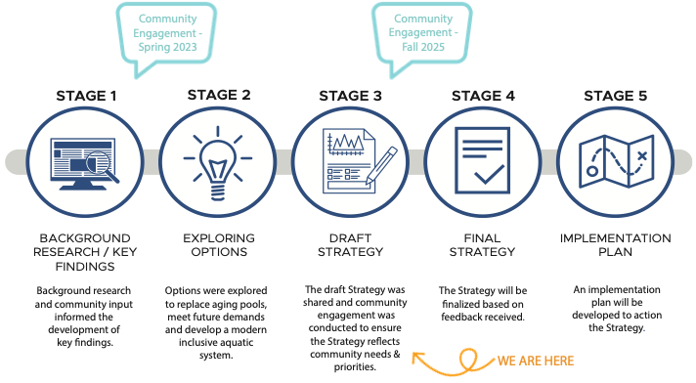
PROCESS UPDATE

Slide 8
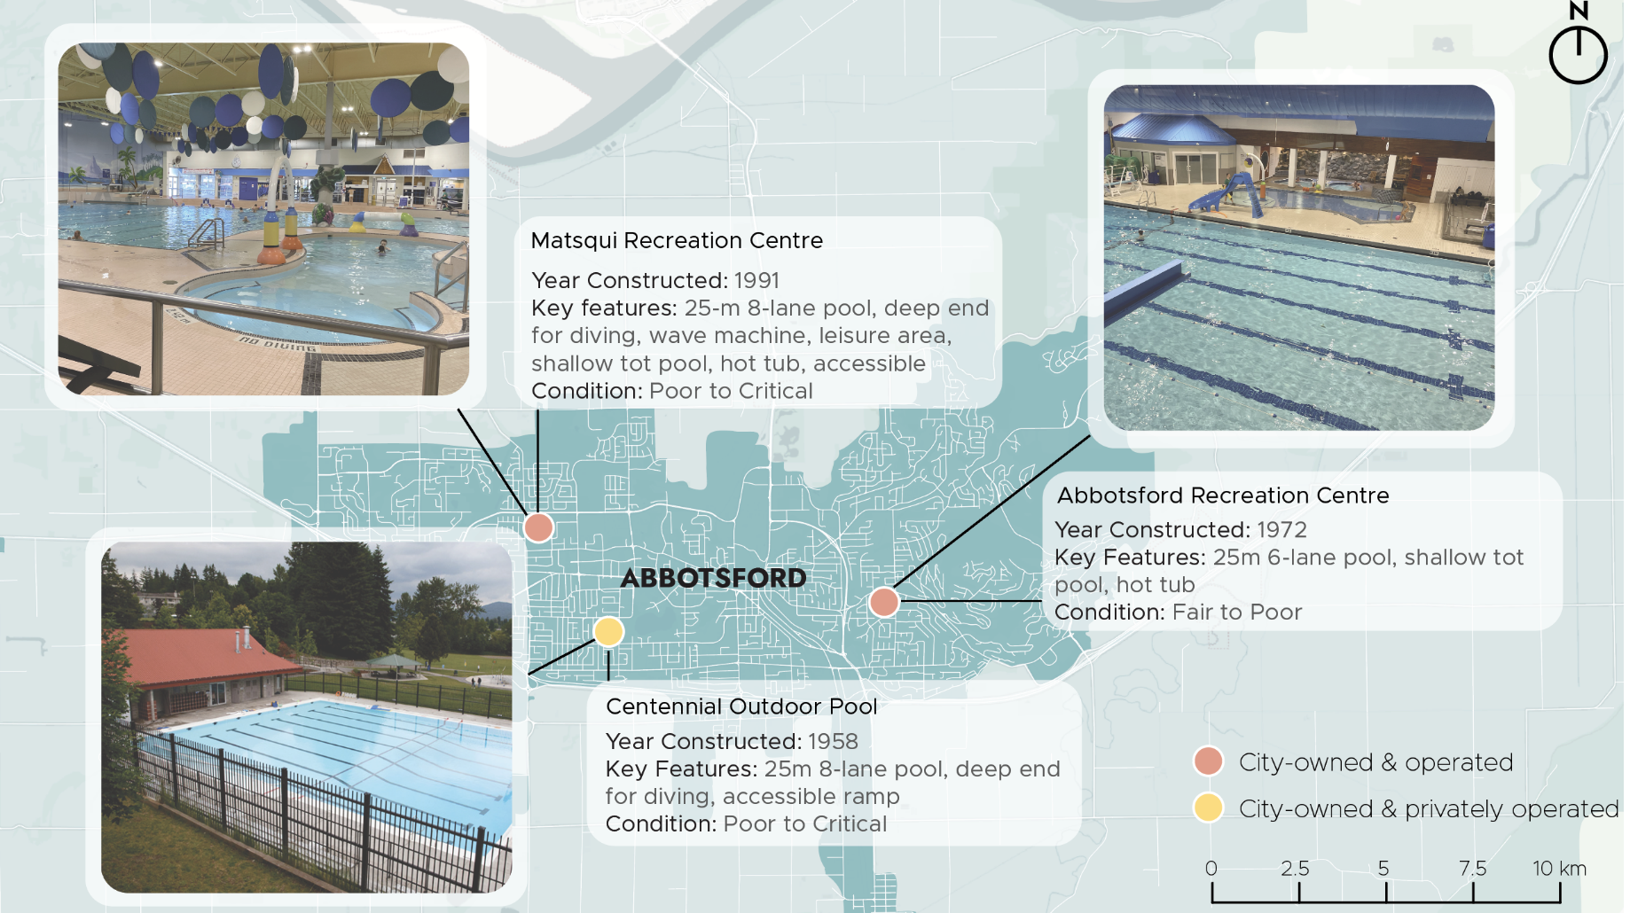
STRATEGY RECAP
Current Aquatic Facility Supply
Level of Service:
  BASIC
  ~3.5 swims per capita
System Capacity:
  555,000 annual swims
Utilization:
  Well utilized, nearing capacity
  101% utilized (system capacity)
  77-98% utilized (booking data)

Slide 9
STRATEGY RECAP
Community Demand Indicators
City Population and Demographic Changes
  % increase in population by 2043
  The population of adults aged 75+ is expected to increase significantly over the next 20 years alongside broader shift from younger age groups (1–29 years) toward middle-aged cohorts (30–54 years).
Recreation Trends:
  Increasing preference for unstructured, informal activities over organized sport
  Increasing reliance on aquatic (and recreation) facilities for social connections
  Growing need for aquatic facilities to support fitness and wellness, rehabilitation and therapy and skill development
Community Needs and Aspirations:
  Demand for additional (and enhanced) aquatic facilities and improved access to drop-in activities and learn to swim programs
  Existing facilities should be updated to address accessibility and equity for residents
  Current system of facilities are well utilized and liked by the community

Slide 10
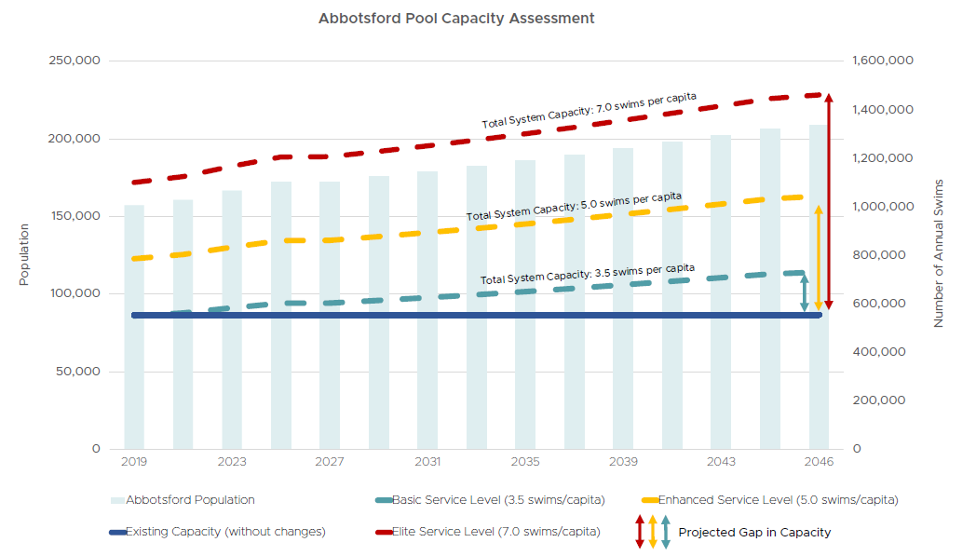
STRATEGY RECAP
Demand Quantified

Slide 11
COMMUNITY FEEDBACK
Goals of Engagement
Expand community awareness of the Strategy.
Understand community preference related to: Level of service, decentralized facility system, training and fitness consolidation to MSA location, implementation timing
Assess overall level of support for proposed strategy
Identify any other concerns related to the draft Aquatic Strategy

Slide 12



COMMUNITY FEEDBACK
Engagement Activities
Community Public
Survey
849
completed
surveys
Interest
Holder Interviews
5
Interviews / workshops
Pop-up
Engagement Events
~80
hours of staffed time
MAIN DATA COLLECTOR

Slide 13
COMMUNITY FEEDBACK
Key Engagement Themes
Overall support: Engagement feedback demonstrated support for the proposed Aquatic Services & Facilities Strategy and its decentralized service delivery model, which was viewed as improving access, equity, and participation.
Aquatic service levels: A strong majority of respondents supported increasing aquatic service levels to 5.0 swims per capita due to growth and capacity constraints.
Facility types and locations: There was broad support for redeveloping MRC and ARC, and for constructing a new aquatic facility at the MSA site. Participants expressed interest in enhancing the MSA facility to better support competitions, fitness, and leisure uses.
Timelines: Many participants expressed a desire to accelerate project timelines, while also recognizing the complexity of planning, funding, and constructing large-scale aquatic facilities.
Programming distribution: The proposed consolidation of swim club and fitness programming at the MSA 50-metre pool was generally supported as a means of relieving capacity pressures at ARC and MRC.

Slide 14
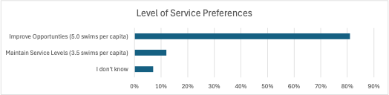
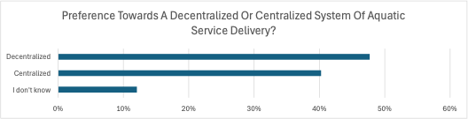
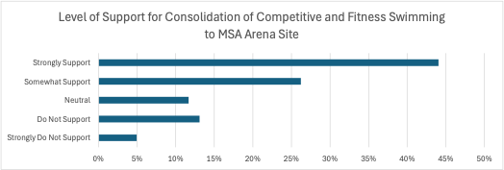
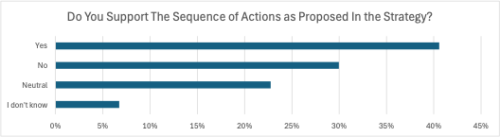
COMMUNITY FEEDBACK
Survey Results (Selection)

Slide 15
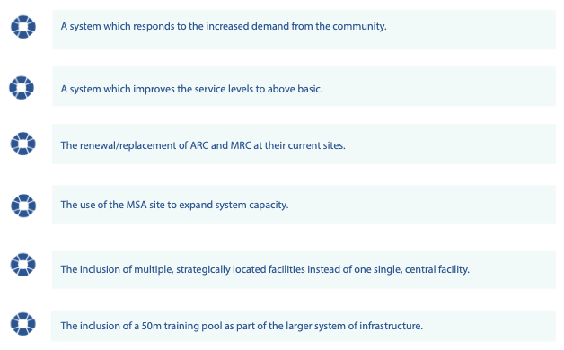
STRATEGY DIRECTION
Strategy Planning Priorities
The Strategy should prioritize:

Slide 16
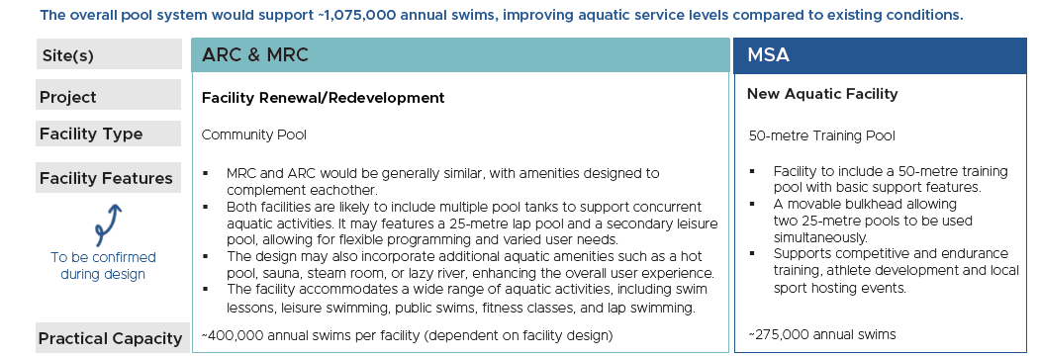
STRATEGY DIRECTION
Proposed Draft Strategy

Slide 17
STRATEGY DIRECTION
50m Training Pool
The 50m Training Pool could accommodate athlete development through training, local and regional sport hosting, and community use through fitness, health and wellness programming and suitable swimming lessons for the community.
While details of facility features such as dryland spaces, starting blocks and suitable space for temporary bleachers will be reviewed during the detailed design process following approval of the Strategy, a notable component of feedback from the community’s swim clubs merits consideration at this point.
The concept of a pool tank with 10 lanes rather than the traditional 8 lanes was brought forward during consultation with the community’s swim clubs.
In discussion, it was noted that this small change in capacity can create significant opportunities for both competitive swimming and community use.

Slide 18
STRATEGY DIRECTION
50m Training Pool
This additional pool width would enable swim meets to have a 25m, or short course, competition with 8 competition lanes and 2 warm-up lanes, effectively allowing the City to activate the other 25m section of the pool tank for community use.
Further, this 10-lane width could also allow two 25m swim meets to occur on either side of the moveable bulkhead, increasing the hosting capacity of the facility.
There would be an increase in initial facility capital costs with this larger aquatic tank, as well as some increases to long term operating costs, but the concept has strong merit both from a competition standpoint and from a dual-use viewpoint.
While the ideal would be the provision of a facility capable of hosting national-caliber events, the reality of Abbotsford’s needs should be based on serving this community.
Staff recommend that the proposed approach in the Strategy still includes a new, specialized 50m Training Pool at the MSA site, but that Stage 4 of the Strategy notes that a 10-lane pool should be a focal point of design and development.

Slide 19
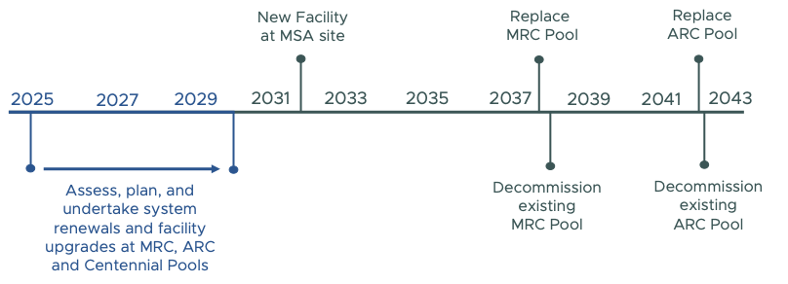
STRATEGY DIRECTION
Proposed Draft Strategy

Slide 20
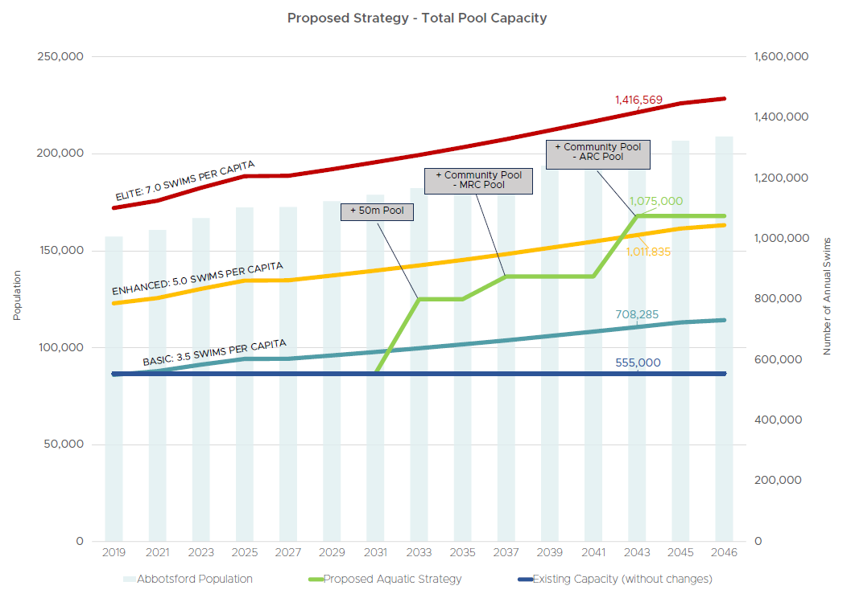
STRATEGY DIRECTION

Slide 21
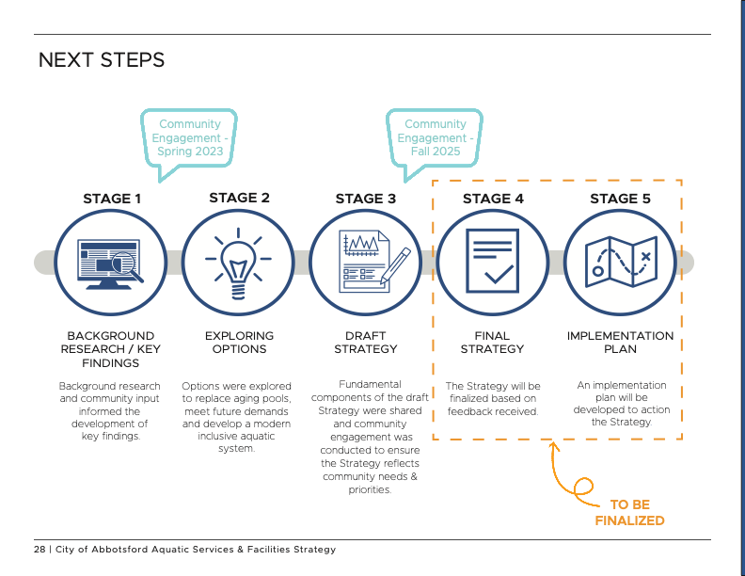
NEXT STEPS

Slide 22
NEXT STEPS
With Council’s approval, community consultation on the Draft Strategy would occur with a focus on informing the community of the changes resulting from the input received through the community consultation in the fall of 2025.
This community consultation on the Draft Strategy will consist of a community wide survey on the Let’s Talk Abbotsford site which will highlight the changes and notable details from the previous community consultation information.

Slide 23
FINANCIAL PLAN IMPLICATIONS
Pending Council’s approval of the Final Strategy, staff will begin the financial planning work necessary to implement the Strategy over the identified time period.
Based on high-level condition assessments and preventative maintenance projection programs the City utilizes, retaining the current operational scope of the MRC pool until 2038 would be $16.99M, with $9.36M required for ARC pool through 2042.
These values are based on 2024 dollars, and are projections based on typical facility operating and capital program standards versus intrusive facility systems physical testing. As such, unforeseen repairs requiring additional capital funding may arise over time.
To deliver some of these proposed strategic projects, staff will be identifying various funding sources for Council’s consideration including long-term debt financing.

Slide 24
IMPACTS ON COUNCIL POLICIES, STRATEGIC PLAN AND/OR COUNCIL DIRECTION
Council’s 2022 – 2026 Strategic Plan, Principle 1 – Inclusive and Connected Community, Goal 3 includes the completion and implementation of the Aquatic Services and Facilities Strategy.

Slide 25
RECOMMENDATION
That Council direct staff to undertake community consultation in advance of the Stage 4 Final Strategy as generally outlined in Report No. PRC 014-2026; and
That, following the community consultation, staff provide the Stage 4 Final Strategy for Council’s consideration.

