Slide 1

Aquatic Services and Facilities Strategy
– Stage 2 Exploring Options
Council Meeting
July 22, 2025
Parks, Recreation and Culture

Slide 2
Purpose
To provide Council with the Stage 2 – Exploring Options of the Aquatic Services & Facilities Strategy and seek approval to undertake community consultation in advance of Stage 3 – Draft Strategy.

Slide 3
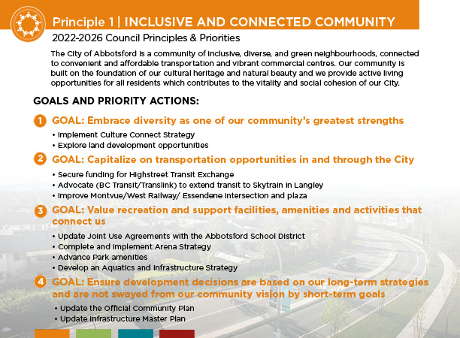
Background

Slide 4
Context
The scope of the Aquatic Services & Facilities Strategy (Strategy) includes:
  Identify the current profile of aquatic programs and activities
  Estimate the current utilization of the infrastructure
  Quantify the future demand for programs and activities
  Quantify the infrastructure required to meet the future demand
  Develop a roadmap to realize the required infrastructure

Slide 5
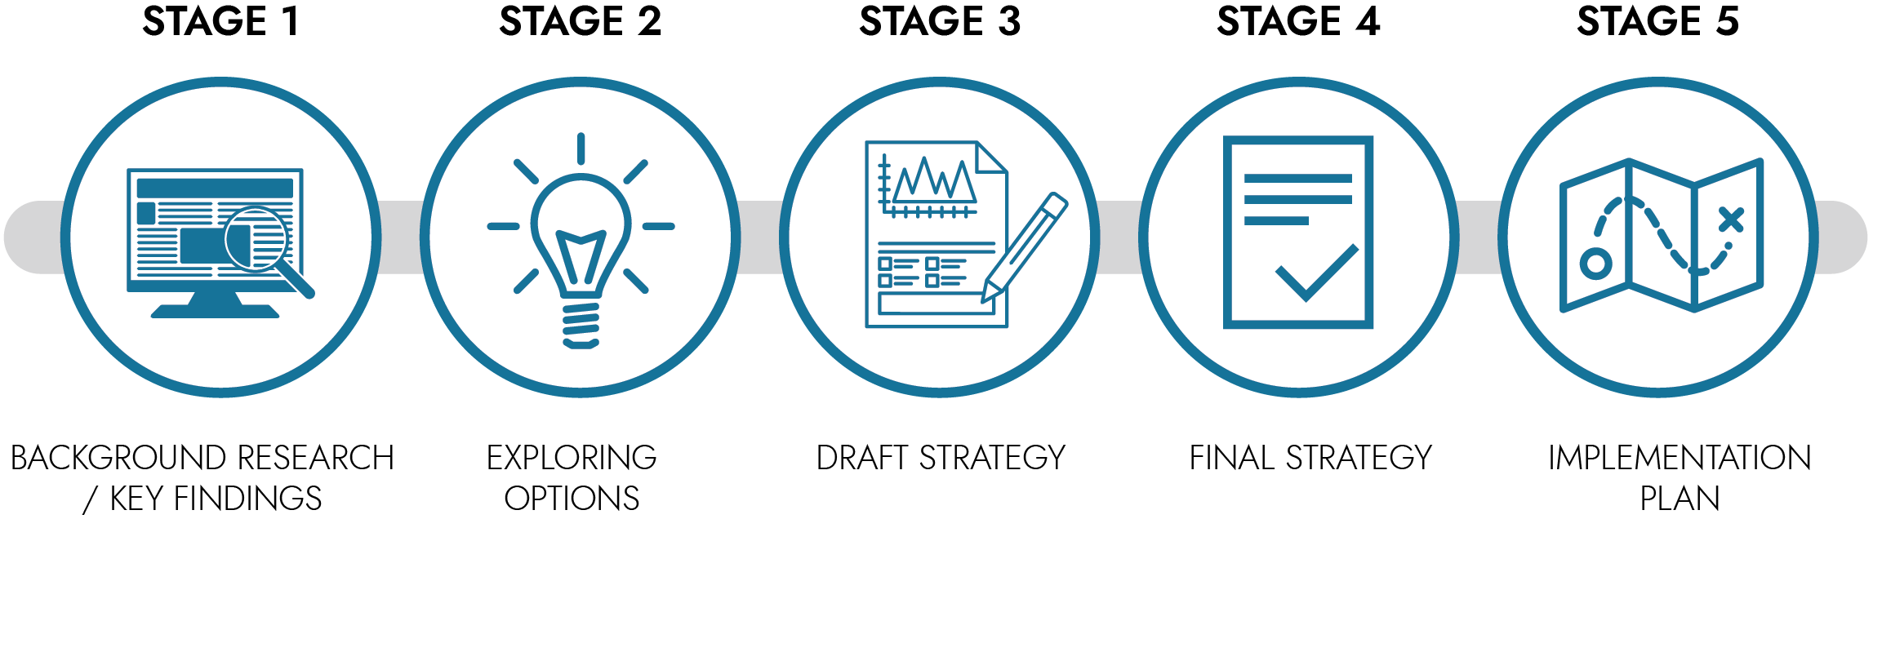

Context
REPORT CONTEXT - Approach
JAN 2023
Council Check-In
Council Check-In
Council Check-In
Council Check-In

Slide 6
Context
Key Findings from Stage 1 of the Strategy include:
  Existing aquatic infrastructure will require major updates, renovations, and possible replacement.
  Pools are well utilized and liked by the community.
  There is an increasing demand for aquatic programming that supports leisure, health and fitness activities.
  Should consider additional aquatic infrastructure to support projected population and demand.
  Aquatic infrastructure requires high capital investments and there is limited cost recovery potential.

Slide 7
Discussion
Location Assessment factors considered:
Population density – where people live
Development growth – what areas will see growth due to development
Urban structure – alignment with the 2016 OCP
Major road network – how people move through the City
Land use designation – what land is suitable for aquatic infrastructure

Slide 8
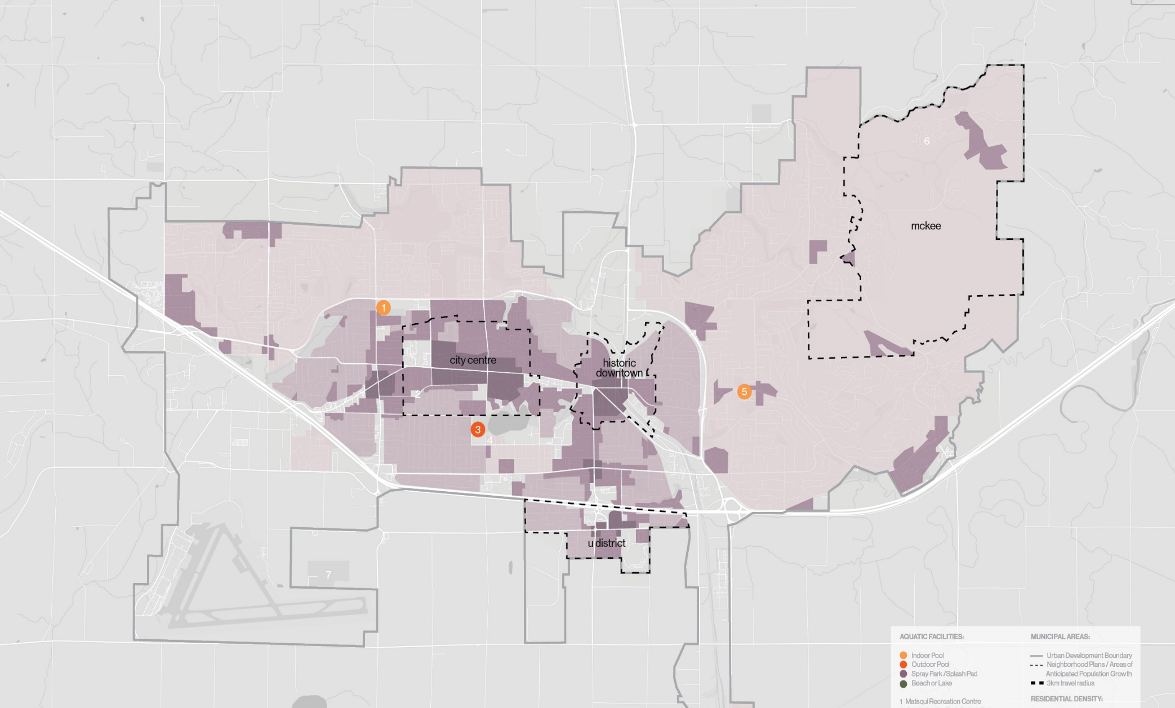
Discussion
Location Assessment and Population Distribution
2023
Centennial
MRC
ARC
Lower Density
Higher Density

Slide 9
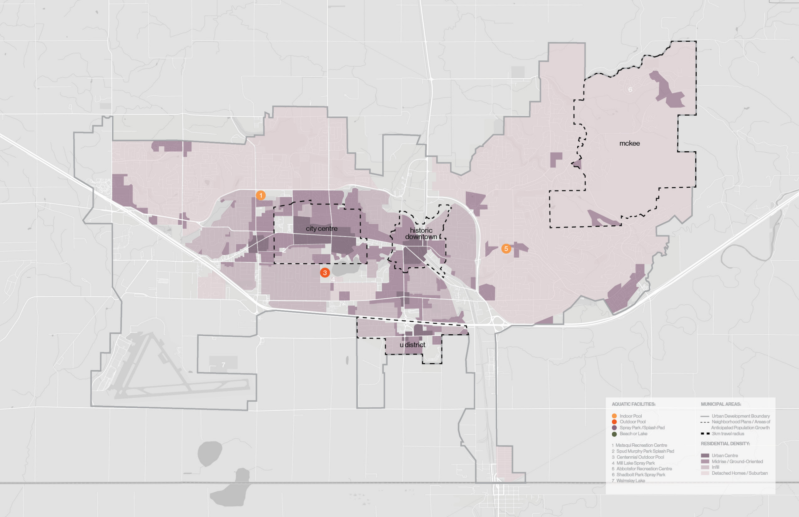
Discussion
2036
Location Assessment and Population Distribution (cont.)
MRC
Centennial
New Neighborhoods
15,000 new residents
35,000 new residents
Infill areas
10,000
new residents
ARC

Slide 10

Discussion
2036
Location Assessment and Population Distribution – includes Transportation and Land Use (cont.)
MRC
Centennial
ARC
Most suitable areas for development of new facility
Lower Density
Higher Density

Slide 11
Discussion
Planning Considerations
Objective: to support an understanding of the relationship between level of service, existing infrastructure, and number and scale of facilities.

Slide 12
Discussion
Planning Considerations
Level of Service
Current system provides BASIC level of service
3.5 annual swims per capita
Assumption that City will continue to provide BASIC to ENHANCED level of service
Level of Service | Expected Annual Swims / Capita
Basic | 3.5 swims/capita
Enhanced | 5.0 swims/capita
Elite | 7.0 swims/capita

Slide 13
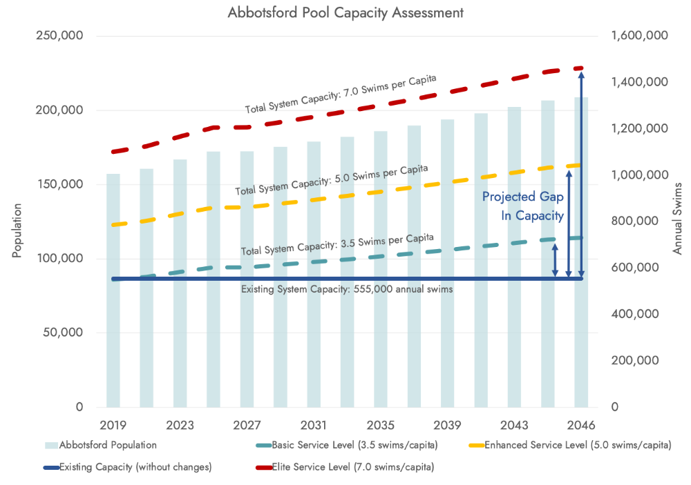
Discussion
Planning Considerations
Level of Service

Slide 14
Discussion
Planning Considerations
Infrastructure Age and Condition
Facility / Asset | Year of Construction (and major renovations) | Facility / Asset Condition* | Approx. Year of Renewal /Replacement
Abbotsford Recreation Centre Pool | 1972, renovation in mid 1990’s | Fair to Poor | 2042
Matsqui Recreation Centre Pool | 1991 | Poor to Critical | 2037
Centennial Outdoor Pool | 1958, renovations in 1996, 2008, & 2022 | Poor to Critical | 2032

Slide 15
Discussion
Planning Considerations
Facility Size and Scale
Destination Pool
~750,000 swims/yr
Community Pool
~400,000 swims/yr
Specialized (Training) Pool
~275,000 swims/yr
Neighbourhood Pool
~200,000 swims/yr
25m six-lane tank
Basic aquatic services for local area
More specialized aquatic amenities and services
Serves ¼ - ½ of City
Comprehensive multi-tank pools
Significant leisure focus
Centrally located, serves majority of City
50m tank
Endurance & competitive training
Athlete development and sport hosting events

Slide 16
PROPOSED STRATEGY – Options Assessed
Discussion
Proposed Strategy
Options Assessed
Accommodation Option Explored | Annual Swim Capacity (Approximate) | Total System Capacity
1 x Destination Pool | 750,000 | 750,000
1 x Community Pool 1 x Neighbourhood Pool | 500,000 250,000 | 750,000
1 x Training 50m Pool 1 x Community Pool 1 x Neighbourhood Pool | 275,000 350,000 200,000 | 825,000
1 x Training 50m Pool 2 x Community Pools | 275,000 350,000 (x2) | 975,000
Preferred Accommodation Options

Slide 17
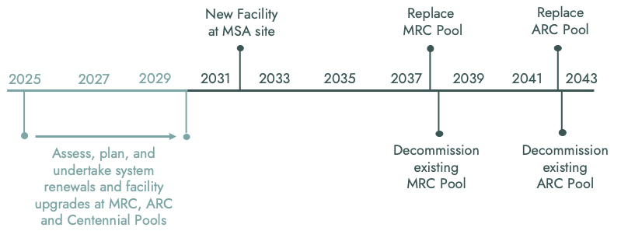
Discussion
Proposed Strategy
Timeline

Slide 18
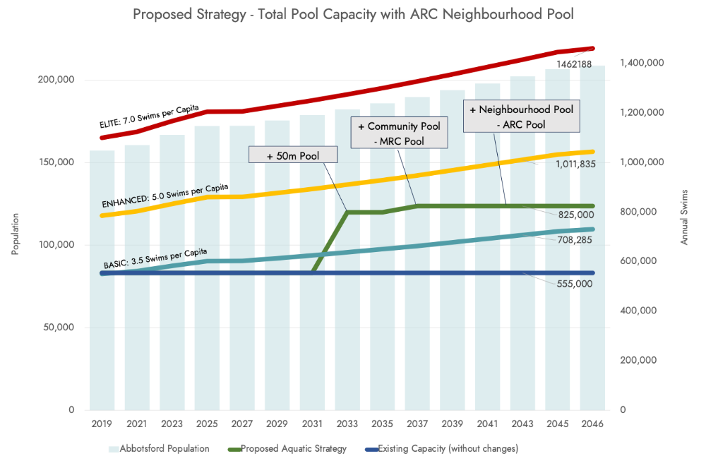
Discussion
Proposed Strategy
Pool Capacity with ARC Neighbourhood Pool

Slide 19
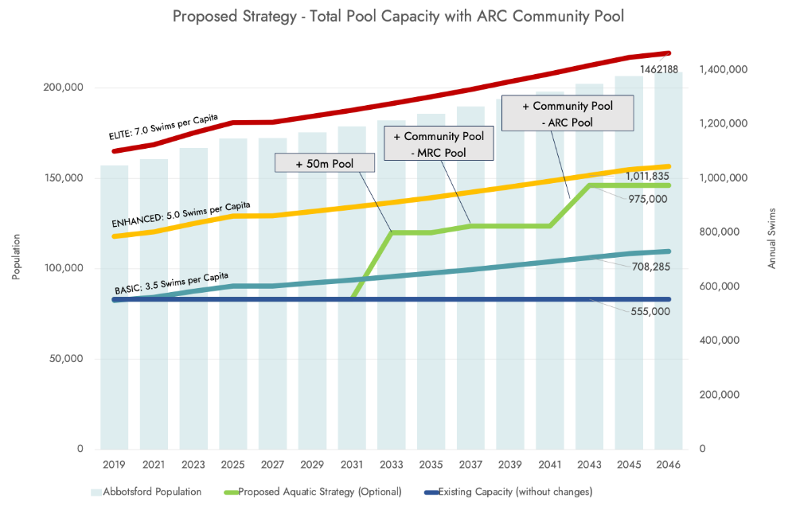
Discussion
Proposed Strategy
Pool Capacity with ARC Community Pool

Slide 20
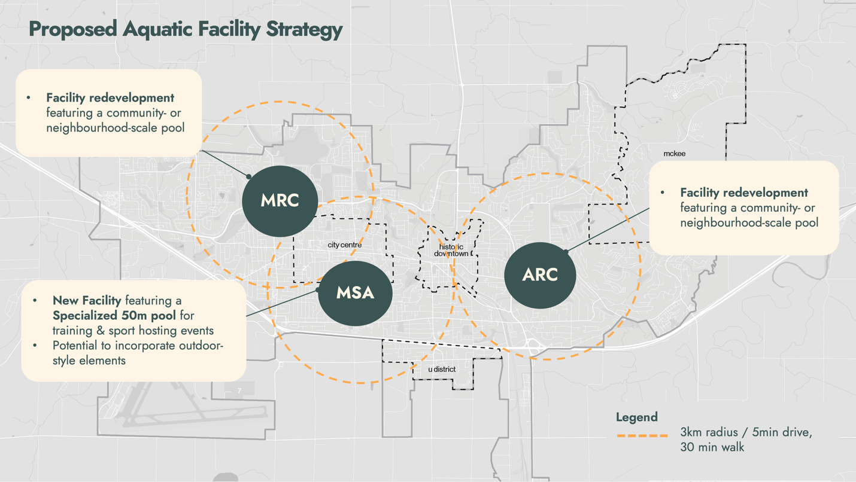
Discussion
Proposed Strategy – Facility Locations

Slide 21
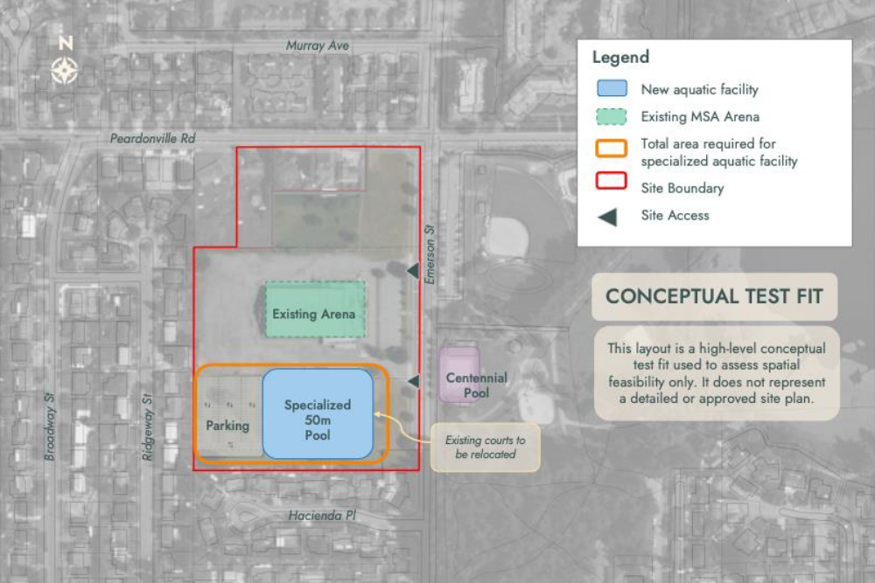
Discussion
Proposed Strategy – MSA Site: New Aquatic Facility Test Fit

Slide 22
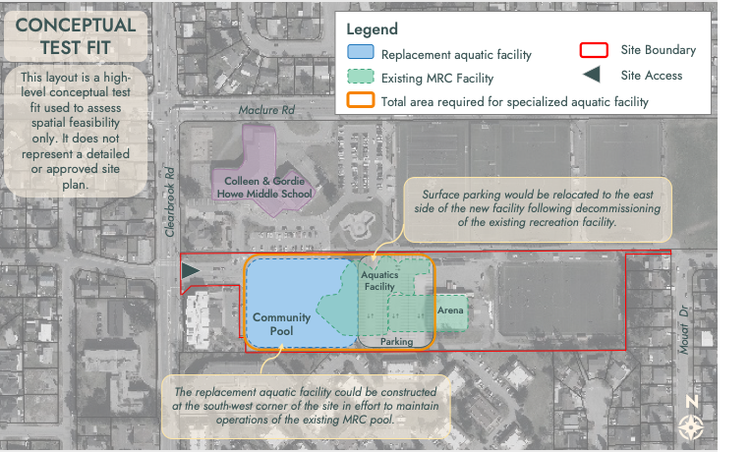
Discussion
Proposed Strategy – MRC Site: New Aquatic Facility Test Fit

Slide 23
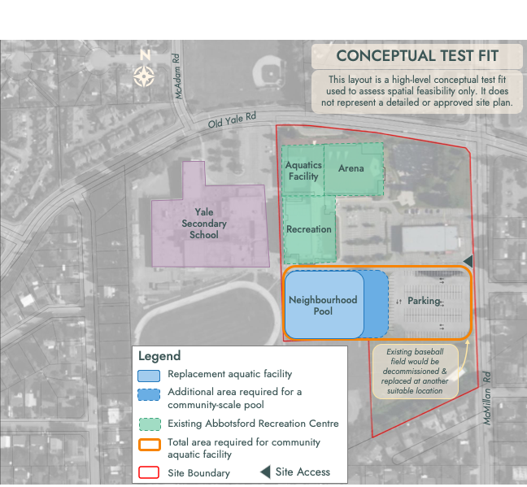
Discussion
Proposed Strategy – ARC Site: New Aquatic Facility Test Fit

Slide 24
Next Steps
JAN 2023
Council Check-In
Council Check-In
Council Check-In
Council Check-In

Slide 25
Next Steps
Upon Stage 2 approval work on Stage 3 Draft Strategy will commence which includes a comprehensive public consultation process.

Slide 26
Financial Implications
Currently, there are no financial implications directly associated with this report.
Pending Council’s approval staff will begin the financial planning work necessarily to realize the direction of the Strategy over the time period identified. To deliver some of these proposed strategic projects, staff will be identifying various funding sources for Council’s consideration including long-term debt financing.

Slide 27
Recommendations
That Council approve the Aquatic Services and Facilities Strategy – Stage 2 Exploring Options report, attached as Attachment A to Report No. PRC 063-2025; and
That staff be directed to undertake community consultation in advance of the Stage 3 Draft Strategy.

