Slide 1
Planning for a Montrose Avenue Transit Exchange
Development, Transportation and Infrastructure
Advisory Committee
June 24, 2021
Engineering and Regional Utilities

Slide 2
Agenda
Purpose
Context
Discussion
Next Steps
Recommendation

Slide 3
Purpose
To provide information to the Committee on the planning of a new Transit Exchange on Montrose Avenue.

Slide 4
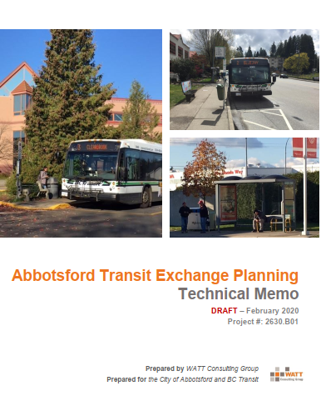
Context
Transit Exchange Planning
  An investment in transit exchange infrastructure is required to:
    Support the City’s future transit network
    Accommodate the increase in transit service levels
    Improve the customer experience
Study recommended five exchanges to serve Abbotsford

Slide 5
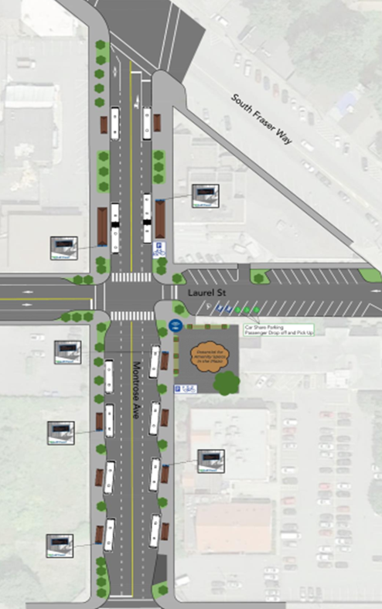
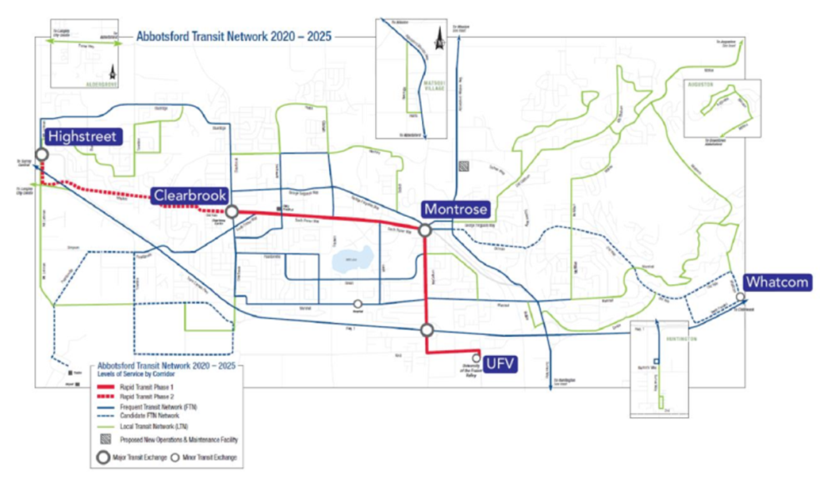
Context
Montrose Exchange Top Priority
  Current transit model is not sustainable
  Removal of the Bourquin Hub
  Revitalisation opportunity for the Historic Downtown
Notes:
Multiple hubs enable the system to complete the transition away from the existing hub at Bourquin (Sevenoaks), which in turn will improve route directness and the ability to reinvest running-time savings into additional service.
The top priority is Montrose as it allows for future Gladwin and YXX expansions.

Slide 6
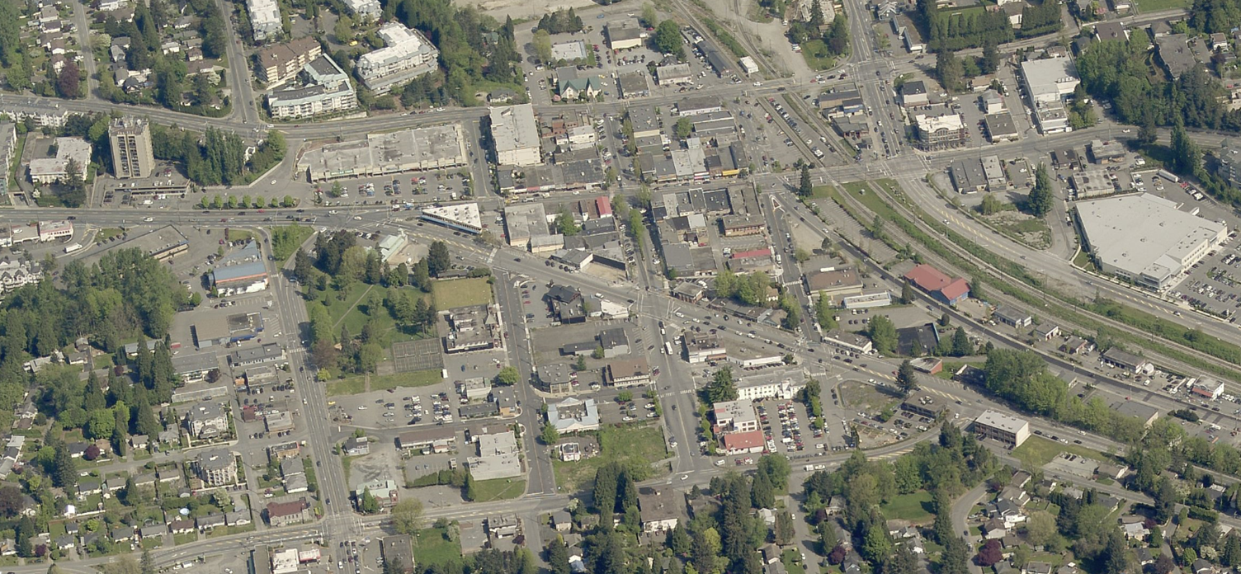

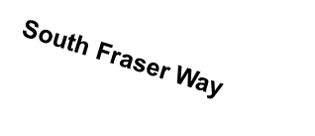
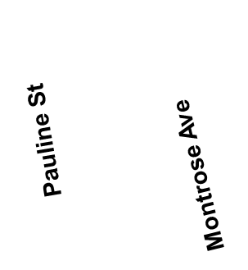
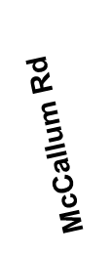

Context
Parking in the Historic Downtown (Off-street supply)
West Railway St

Slide 7
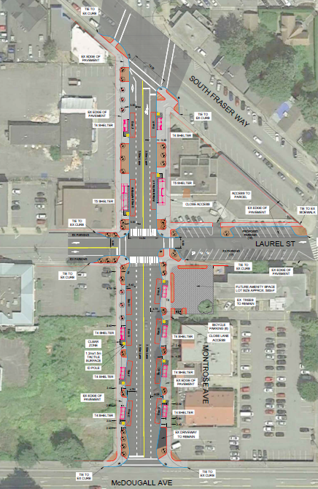
Discussion
Montrose Attributes:
  Transit capacity of up to 12 buses
  New shelters and bench seating
  EV charging and bicycle lockers
  Universally accessible with wide sidewalks
  WiFi, improved lighting, & security cameras
  Mature trees with new landscaping
  Underground the overhead utilities
  Adjacent parking on Laurel Street
  New crosswalks
  Wayfinding signage
Notes:
The opportunity to revitalize Montrose Avenue from McDougall to South Fraser Way is presented with this project.

Slide 8
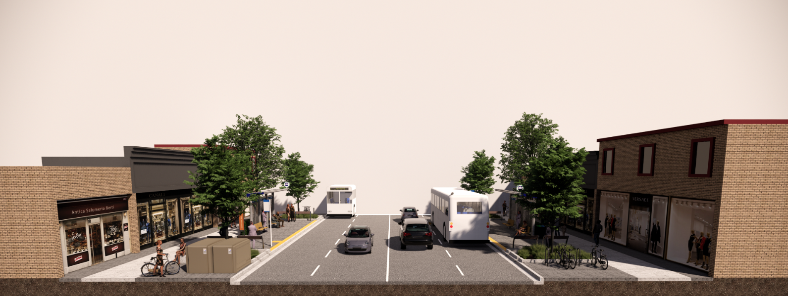
Discussion
Estimated Cost: $5.2M
  Inclusive of: engineering, utility undergrounding, construction, traffic management, and contingency
  Investing in Canada Infrastructure Program (ICIP) provides multiple years of funding for transit related projects
    40% Federal | 40% Provincial | 20% Municipal
Notes:
The cost split for Abbotsford is extremely favourable at just over a $1M contribution.
BC Transit makes the application, City to deliver the project
Rendering shows the form and character of Montrose

Slide 9

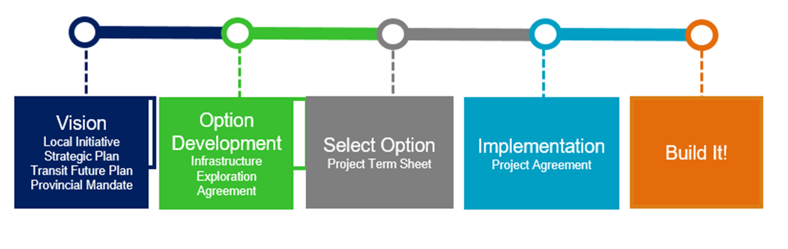
Discussion
Project Development Process
We are here
BC Transit business case development
Application to ICIP
Public Engagement in exchange concept
Notes:
Project Planning has advanced to the Public Engagement stage, and application to ICIP program by BC Transit.

Slide 10
Next Steps
City advancing preliminary design
BC Transit to approve the business case
Public engagement by City staff
BC Transit to apply to the Investing in Canada Infrastructure Program in the fall
Complete design (Winter)
Project tender if funding is secured
Project delivery by City staff

Slide 11
Recommendation
THAT the Committee support this update on the City’s planning initiatives for a new Transit Exchange on Montrose Avenue.

Slide 12
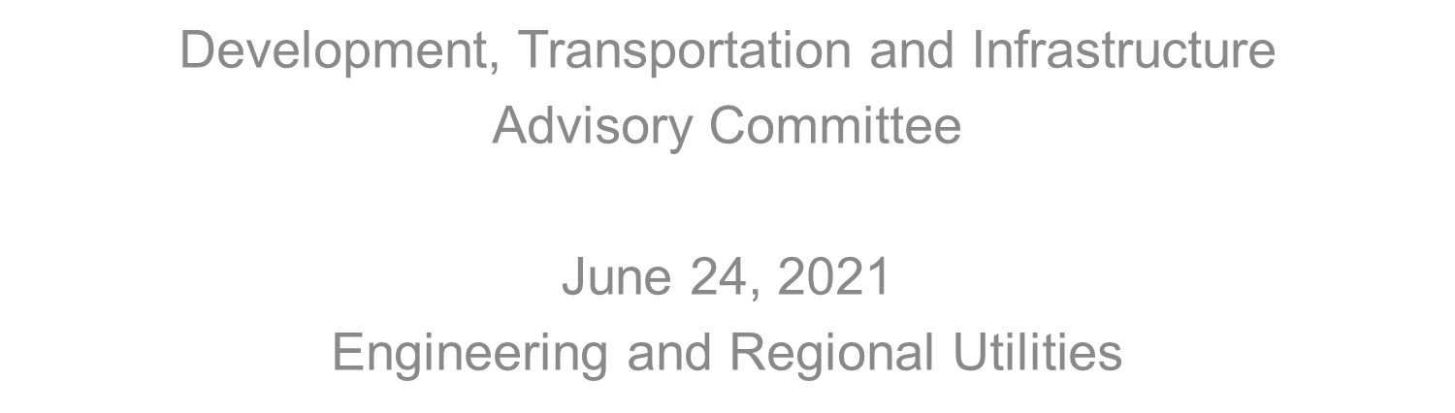
Questions?

